Slide 1

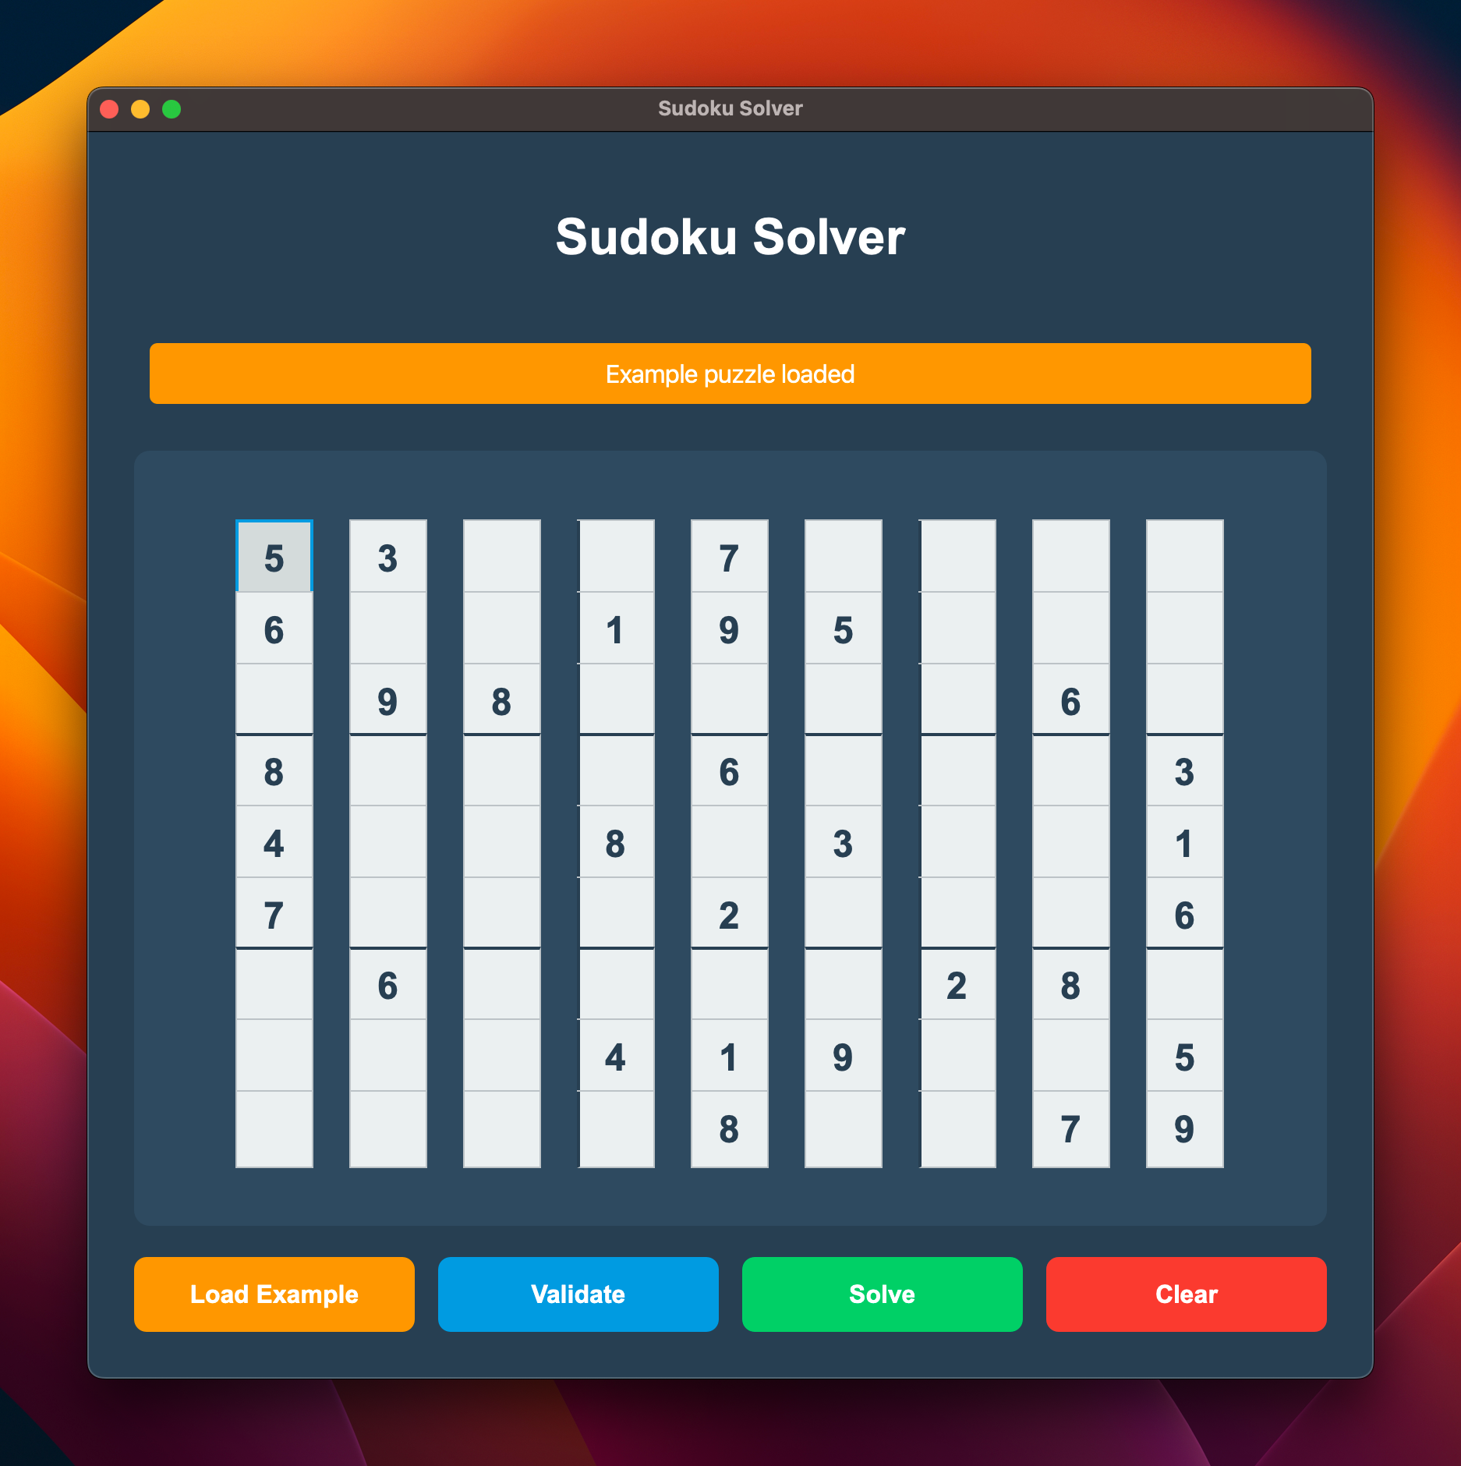
Sudoku Solver Using Ternary Search Tree
Bibas Kandel
Aditya Sharma
Mandip Adhikari
Saleep Shrestha
Professor Christopher McDaniel
CSC 307 H002
Presentation by

Slide 2
Project Background
Aims to solve Sudoku puzzles efficiently using Ternary Search Tree (TST) and constraint propagation
Combines personal interest in Sudoku with a real-world application of computer science concepts

Slide 3
Data Structure Used
Ternary Search Tree (TST):
A Ternary Search Tree is a type of tree that stores strings (or sequences) in a space-efficient manner
Each node has three children: left, equal, and right
A Binary Search Tree (BST) stores and compares entire keys at each node, whereas a Ternary Search Tree (TST) stores individual characters or digits

Slide 4
Responsibilities
Aditya Sharma: Presentation and proposal writing
Bibas Kandel: Lead backend developer
Mandip Adhikari: Lead GUI developer
Saleep Shrestha: Project manager, Tester and Debugger

Slide 5
Project Demonstration

Slide 6
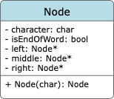
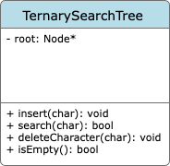
UML Diagram

Slide 7
Challenges and Success
Challenges:
Implementing TST for efficient candidate management
Balancing constraint propagation with backtracking for optimization
Debugging complex interactions between the solving algorithm and data structure
Success:
Developed a functional TST-based approach
Fully functional GUI with real time data validation
Optimized the solving algorithm for speed and accuracy

Slide 8
Thank You!

